Slide 1
McKinney ARC
Field Day 2021
North Texas Section
Class 3A
2500 Bloomdale
McKinney, Texas
June 26-27
Notes:
Update 2003 pin icon

Slide 2
What is Field Day?
Field Day is ham radio's open house. Every June, more than 40,000 hams throughout North America set up temporary transmitting stations in public places to demonstrate ham radio's science, skill and service to our communities and our nation. It combines public service, emergency preparedness, community outreach, and technical skills all in a single event. Field Day has been an annual event since 1933 and remains the most popular event in ham radio.

Slide 3
Purpose of Field Day
Learn to operate in abnormal situations in less-than-optimal conditions
Develop skills to meet the challenges of emergency preparedness
Acquaint the general public with the capabilities of Amateur Radio
To work as many stations as possible on all bands excluding the 60, 30, 17, and 12-meter bands

Slide 4
MARC Goals for Field Day
Have fun!
Introduce new MARC members to Emergency operations setup and coordination
Give as many MARC members as possible the change to get on the air
Make as many QSO’s as possible
Meet new people, make new friends
Introduce new people to amateur radio
Introduce new Ham radio areas of interest
And did we mention, Have fun!

Slide 5
Date and Time
June 26-27
Operating begins 1800 UTC (1 PM) Saturday June 26
Ends 1800 UTC (1 PM) Sunday June 27

Slide 6
Operate from Home
The COVID-19 pandemic-modified ARRL Field Day rules from 2020 will continue this June with the addition of a power limit imposed on Class D (Home Stations) and Class E (Home Stations-Emergency Power) participants. The news from the ARRL Board’s Programs and Services Committee comes as many clubs and groups are starting preparations for Field Day in earnest. Field Day 2021 will take place June 26 – 27.
“This early decision should alleviate any hesitancy that radio clubs and individual Field Day participants may have with their planning for the event,” said ARRL Contest Program Manager Paul Bourque, N1SFE.
For Field Day 2021:
•Class D stations may work all other Field Day stations, including other Class D stations, for points. This year, however, Class D and Class E stations will be limited to 150 W PEP output.
•An aggregate club score will be published — just as it was done last year. The aggregate score will be a sum of all individual entries that attributed their score to that of a specific club.

Slide 7
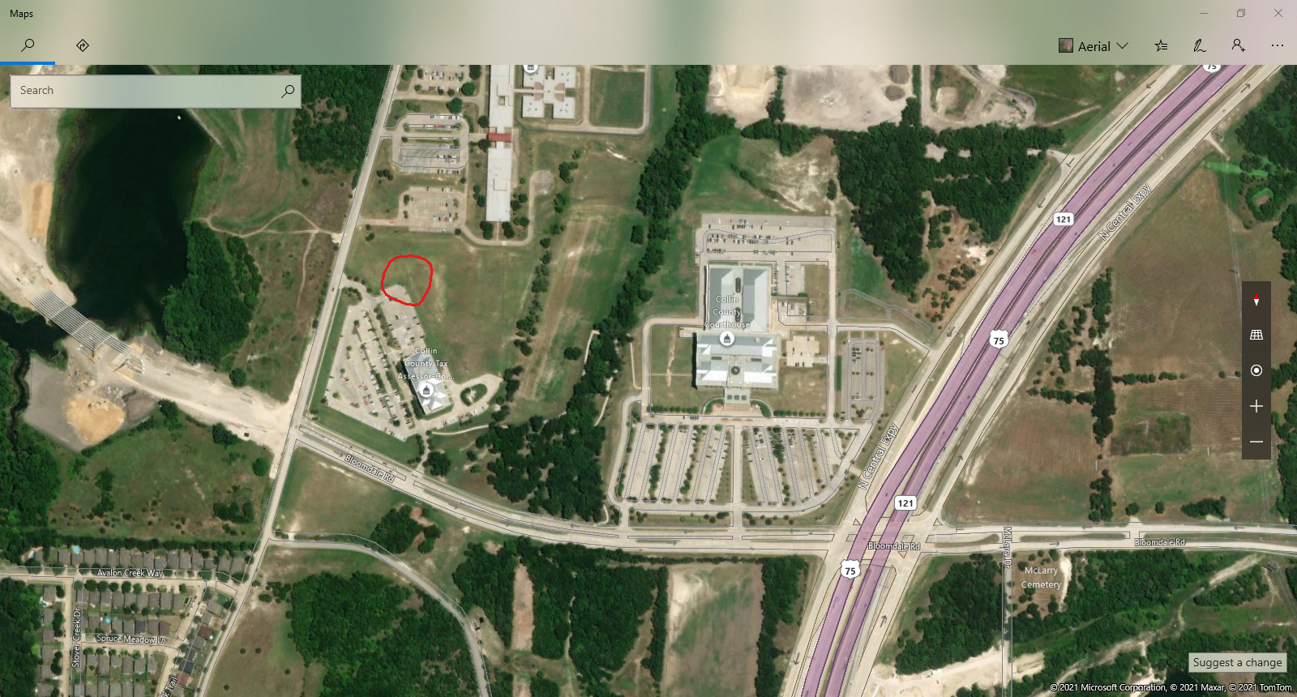
Location
2500 Bloomdale
McKinney, TX 75071

Slide 8
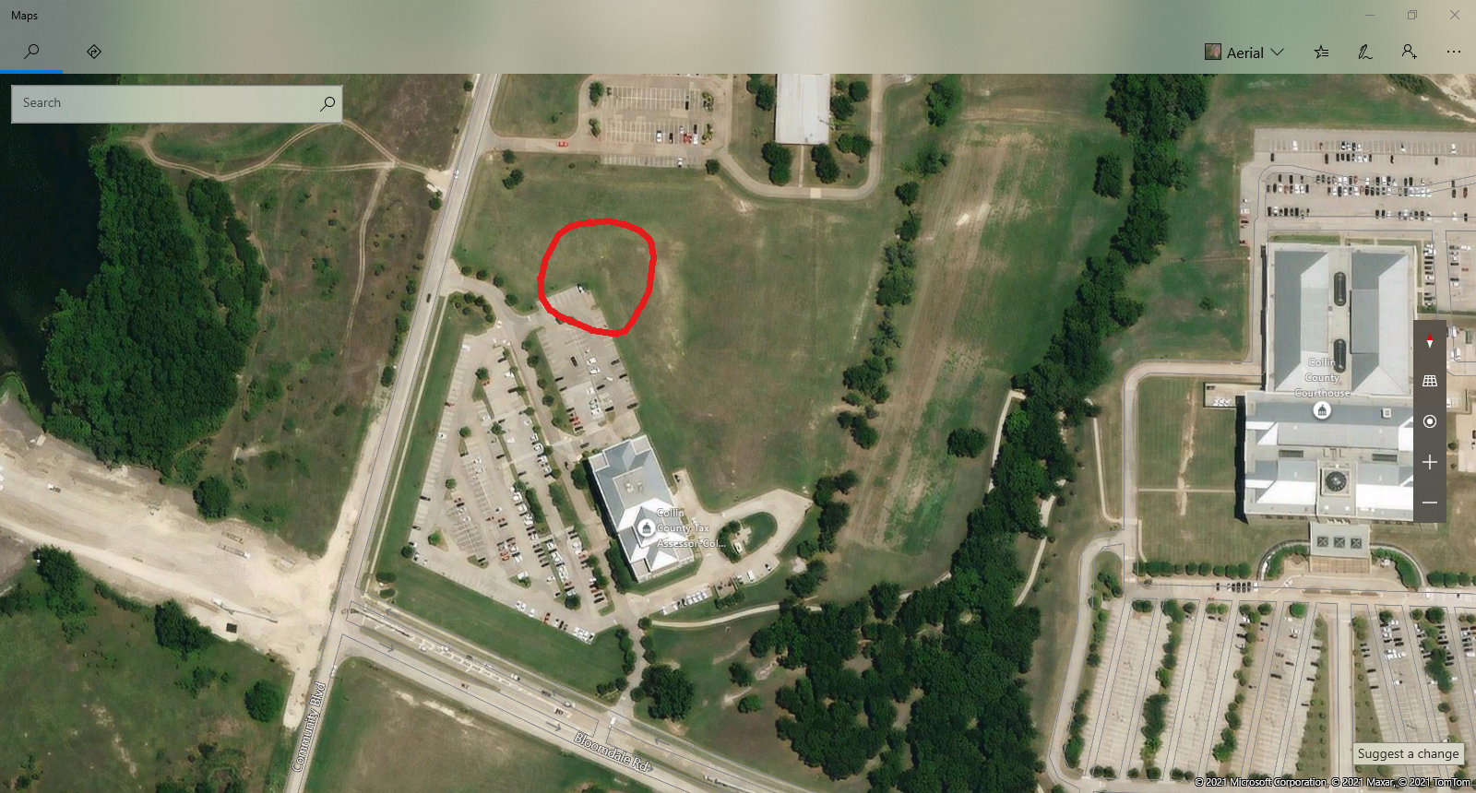
Location
2500 Bloomdale
McKinney, TX 75071

Slide 9
Number of Stations and Entry Category
Operate as Category 3A
  Class A means we are a club running on emergency power
  “3” means three simultaneously transmitted signals
    3 HF Stations
Operate under call sign W5MRC

Slide 10
Exchanging Information
CW and Digital
  CQ CQ CQ FD DE W5MRC [W5MRC] K
  3A NTX
PHONE
  CQ Field Day, CQ Field Day. This is W5MRC [Whiskey 5 Mike Romeo Charlie] standing by/listening (or “Q R Zed”).
  Copy 3A NTX ,3 Alpha North Texas
  Some common Q-Codes
  QRZ = “Who is calling?”
  QSL = “Can you acknowledge receipt ? ”
  QTH = “What is your location?”

Slide 11
Band Plan
Primarily 15 and 20 meters during the day.
40 or 80 meters at night.
Operators' choice for open bands, just make sure the same mode is not operating on the same band at the same time.
Work as many stations as possible on all bands excluding the 60, 30, 17, and 12-meter bands
Notes:
May try to have second 40M antenna for CW during GOTA.

Slide 12
Scoring – QSO Points
Phone contacts are one point each
CW and digital contacts are two points each

Slide 13
Scoring – Bonus Points
100% Emergency Power (a generator qualifies), 100 points per transmitter (GOTA and VHF stations do not count)
Site Visitation by an elected governmental official, 100 points
Media Publicity, 100 points
Public Location, 100 points
Public Information Table, 100 points
Message Origination to Section Manager, NTS style formal message, 100 points

Slide 14
Scoring – Bonus Points (Cont’d)
Satellite QSO, one or more successful QSOs via amateur satellite, 100 points
W1AW Bulletin, special Field Day bulletin copied via amateur radio, 100 points
Learning Opportunity/Seminar
Site Visitation by a representative of an agency served by ARES, e.g. Red Cross, local Emergency Management, or law enforcement, 100 points

Slide 15
Logging
N3FJP logging software will be utilized on all computers
Please make sure to switch operators in the software when new person is operating.

Slide 16
“Volunteers” are Critical for MARC Success
Safety Officer,Equipment Manager (Inventory, transportation) – Dave Piekarski
Rules – Sid Gibson/Mike Flusche
Publicity – Newspaper, City Officials, public – Bob DeVance
Antennas – Dave Piekarski/?
Report to ARRL – Sid
Logging/Networking – Open
Tower Transport (Need Flat Bed Trailer) – Open
Safety Officer Understudy – Open

Slide 17
Additional Help Needed
Sign up link sent via email
Volunteers for setup/takedown
Volunteers to copy W1AW bulletins
Volunteers to work Satellites during Field Day
Setup will begin @ 08:30am, June 26
Takedown will begin @ 13:00, June 27
Volunteer with flat bed trailer to haul towers
Notes:
Need Band Captain volunteers. Primary responsibility is to make sure the equipment gets set up and ready to operate by 1:00, answer questions about equipment and logging program, if needed. 80 Meter band captain needs to make sure that antenna gets put up, and switch equipment to band after 15 shuts down. 40 Meter band captain responsible for setting up GOTA station.
Volunteer for Satellite QSO, message to SM, and traffic handling mentioned previously.
Need someone available during the peak visitor hours to man the GOTA station and help operators/act as a Control Operator as needed.
We are putting up 4 towers this year. Need to make sure plenty of ground crew are available for set up Saturday morning and tear down on Sunday.
What time will tower be at site?

Slide 18
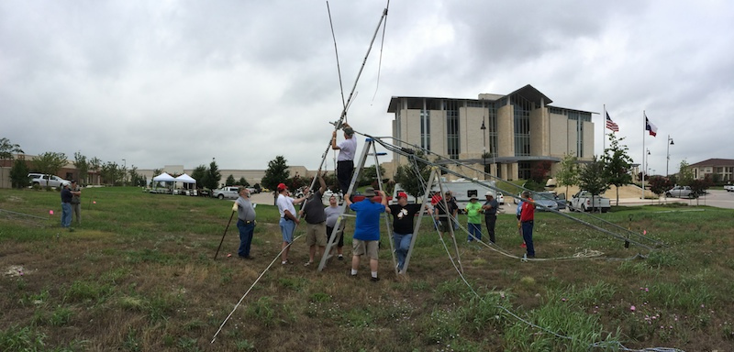

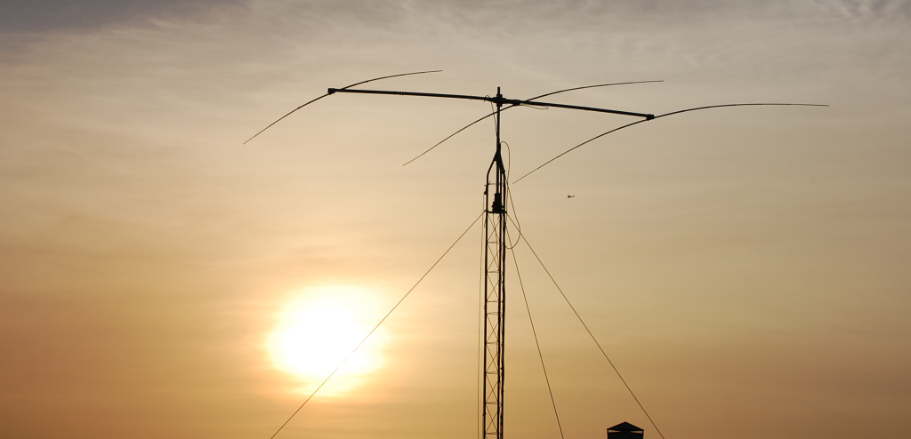
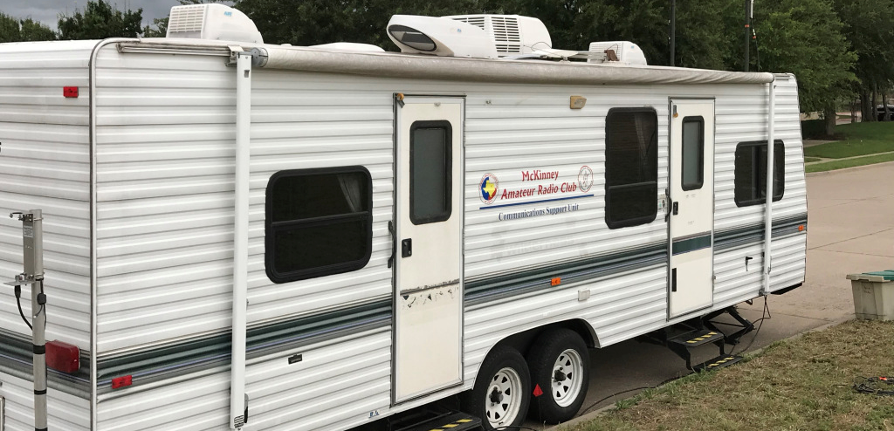

Slide 19
Questions/Comments?
Please bring your own lawn chairs
Club will have two canopies
Welcome to bring family and friends out
No meal planned this year, welcome to bring a meal out and join us!

